Slide 1
Design for Verification Project Update
2021-03-29
Eldrick Millares, Jack Humphries (eldrick, jhumphri@stanford.edu)

Slide 2
Recap:
Goal: Deploy SQED + SSS on new designs:
Simple Design - steelcore
Complex Design - TBD (NeoRV32, BOOM, …)
Use results from new designs to:
Inform our formal proof and possibly generate new constraints
Generate interesting case studies for our Design for Verification framework

Slide 3
Deploy Demo on Simple Designs - Background
Deployed SQED + SSS on the steel core
RV32I + Zicsr + Zxm (Integer + CSR + Machine Mode Privilege)
3 Stage, In-Order Pipeling
Verilog
Similar to vscale complexity
With exception of multiplication support

Slide 4
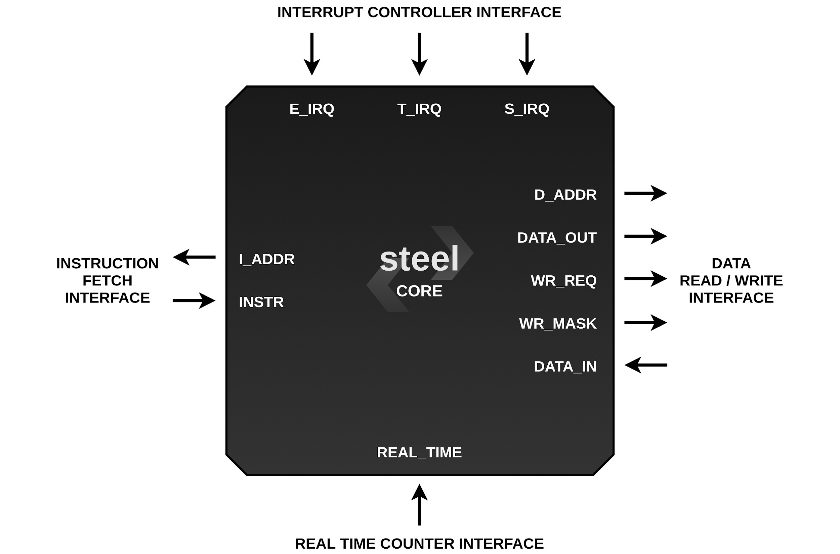
Image Credit: https://rafaelcalcada.github.io/steel-core/steelio/

Slide 5
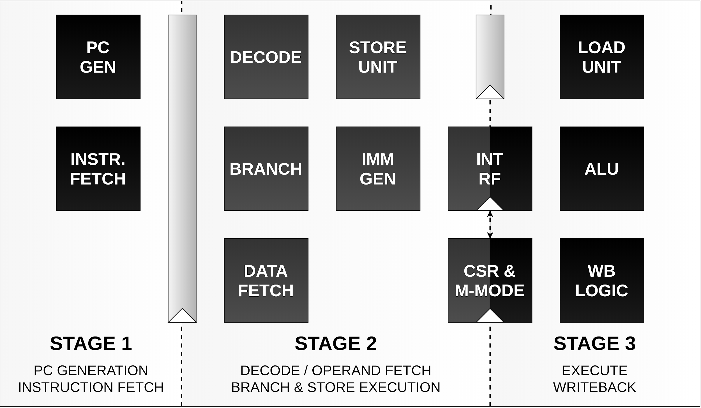
Image Credit: https://rafaelcalcada.github.io/steel-core/uarch/

Slide 6
Deploy Demo on Simple Designs - Current Status
Completed initial integration of QED module + current constraints for steel
Generated QED Module + Supplemental Files
Wired up QED Module to design
Added instruction-commit tracking logic for symbolic starting states constraints
Wrote properties and directives for Questa
Currently iterating on further constraints and wire-up to remove uninteresting counterexamples
Using upscale-project/sqed-generator to create QED files
Currently submitting bug reports related to Questa toolchain to the repo

Slide 7
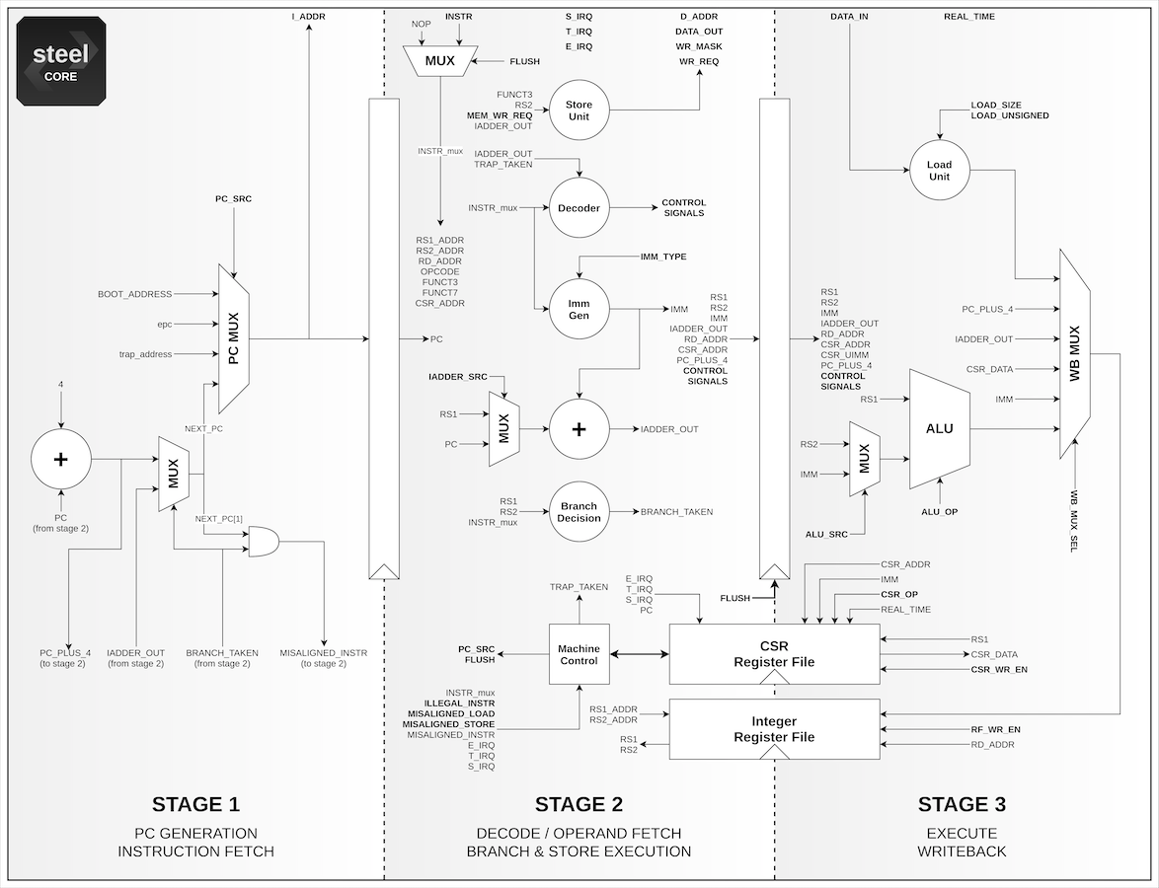
Image Credit: https://rafaelcalcada.github.io/steel-core/uarch/

Slide 8
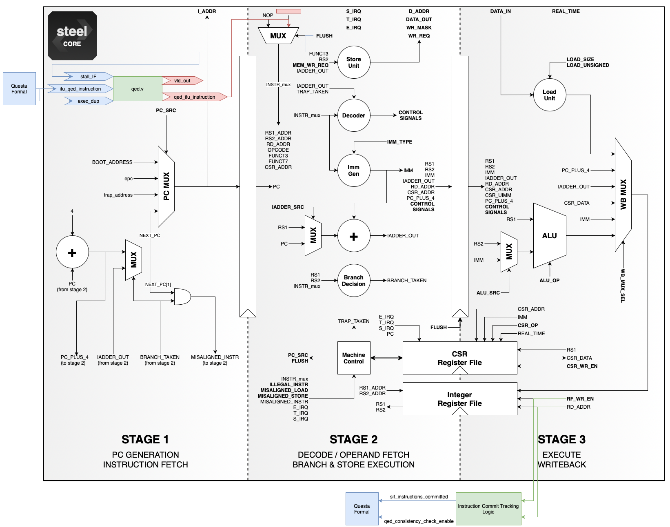
Image Credit: https://rafaelcalcada.github.io/steel-core/uarch/

Slide 9
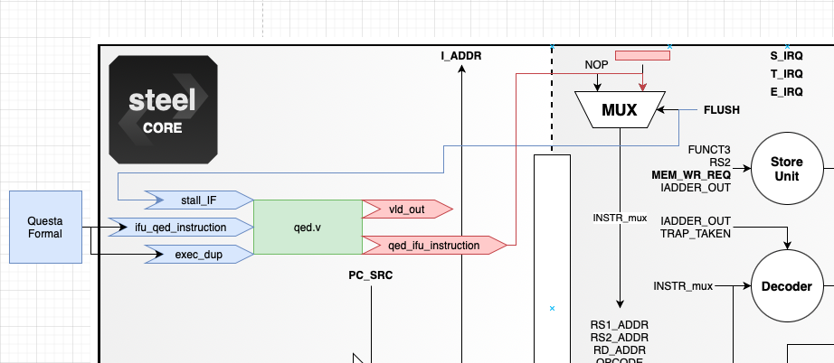
QED Module Wire-Up
Image Credit: https://rafaelcalcada.github.io/steel-core/uarch/

Slide 10
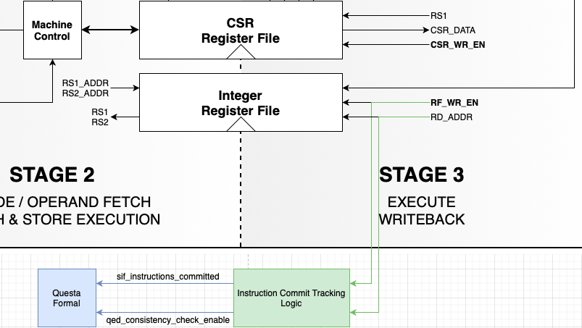
Commit Tracking Logic for Symbolic Starting States
Image Credit: https://rafaelcalcada.github.io/steel-core/uarch/

Slide 11
Deploy Demo on New Designs - Next Steps
Finishing constraints for a “clean” SQED run on steel
Handling CSR
Handling of QED module signals interaction with design (pipeline flush)
Instruction constraints (need to remove MUL* instructions)
Find interesting counterexamples to inform DFV constraints
Do we have a better way of inspecting a counterexample trace?
Considering writing a Python tool + UI to allow easier / faster inspection of signal values
Can our technique catch bugs in the Instruction Fetch stage?

Slide 12
SQED + SSS Deployment is Non-Trivial!
Notes:
Requires intimate knowledge of the design in order to properly constrain starting states and correctly wire up QED module

Slide 13
Deployment Template + Tutorial - Current Status
Not going to be the last time we deploy on new designs
Created a template + tutorial for future SQED deployment demos
Currently tailored for Questa EDA Toolchain (QuestaSim + QuestaFormal)
Inspired by the upscale-project/generic-sqed-demo (Yosys + Pono)
Very excited about the upscale project

Slide 14
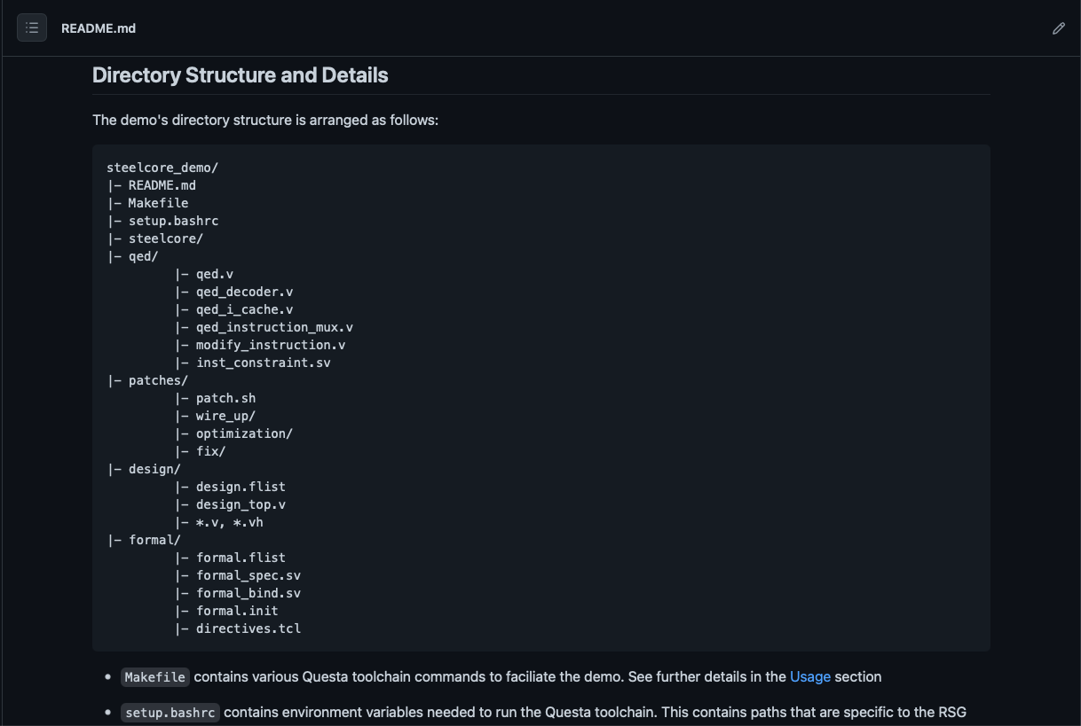
Includes starter files + recommended directory structure

Slide 15
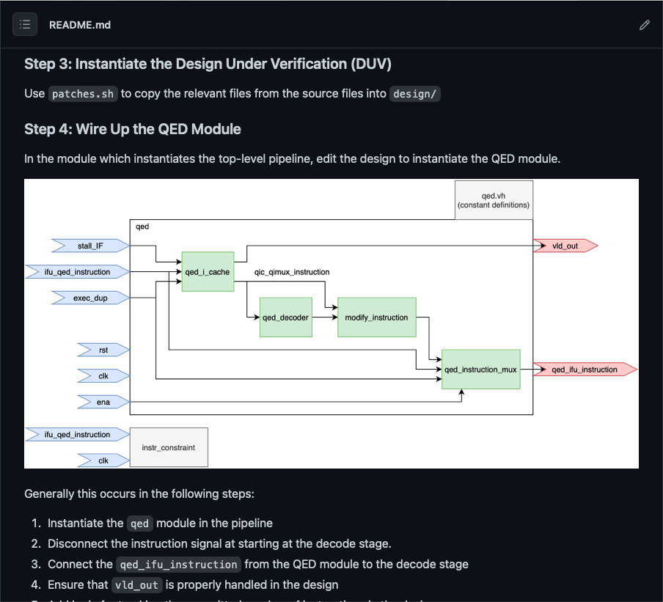
Includes step-by-step instructions
Notes:
Step by step outline of how to get this up and running - balancing specificity with generalizability to other designs
Gives a list of what files the designer should be expecting to edit and where they can expect to spend their effort

Slide 16
Template + Tutorial can be all found in: https://github.com/eldrickm/sqed_sss

Slide 17
Deployment Template + Tutorial - Next Steps
Additional documentation and diagrams to follow
Exploring ways to making a “DFV” constraint library
Will be used to deploy to the complex design we are targeting next

Slide 18
Current Status Summary
Deployed initial SQED + SSS demo to steel
Created template + tutorial for SQED + SSS deployment to other designs for Questa toolchain

Slide 19
Next Steps Summary
Iterating on properly constraining steel for “clean” SQED run
Developing better tools for counterexample analysis
Cataloging interesting counterexamples
Revising and adding to template and tutorial
Identifying and deploying to complex design

